Slide 1

Anavryta Model Lyceum Model United Nations 2026
1st Student Officers’ Lesson:
Rules of Procedure

Slide 2
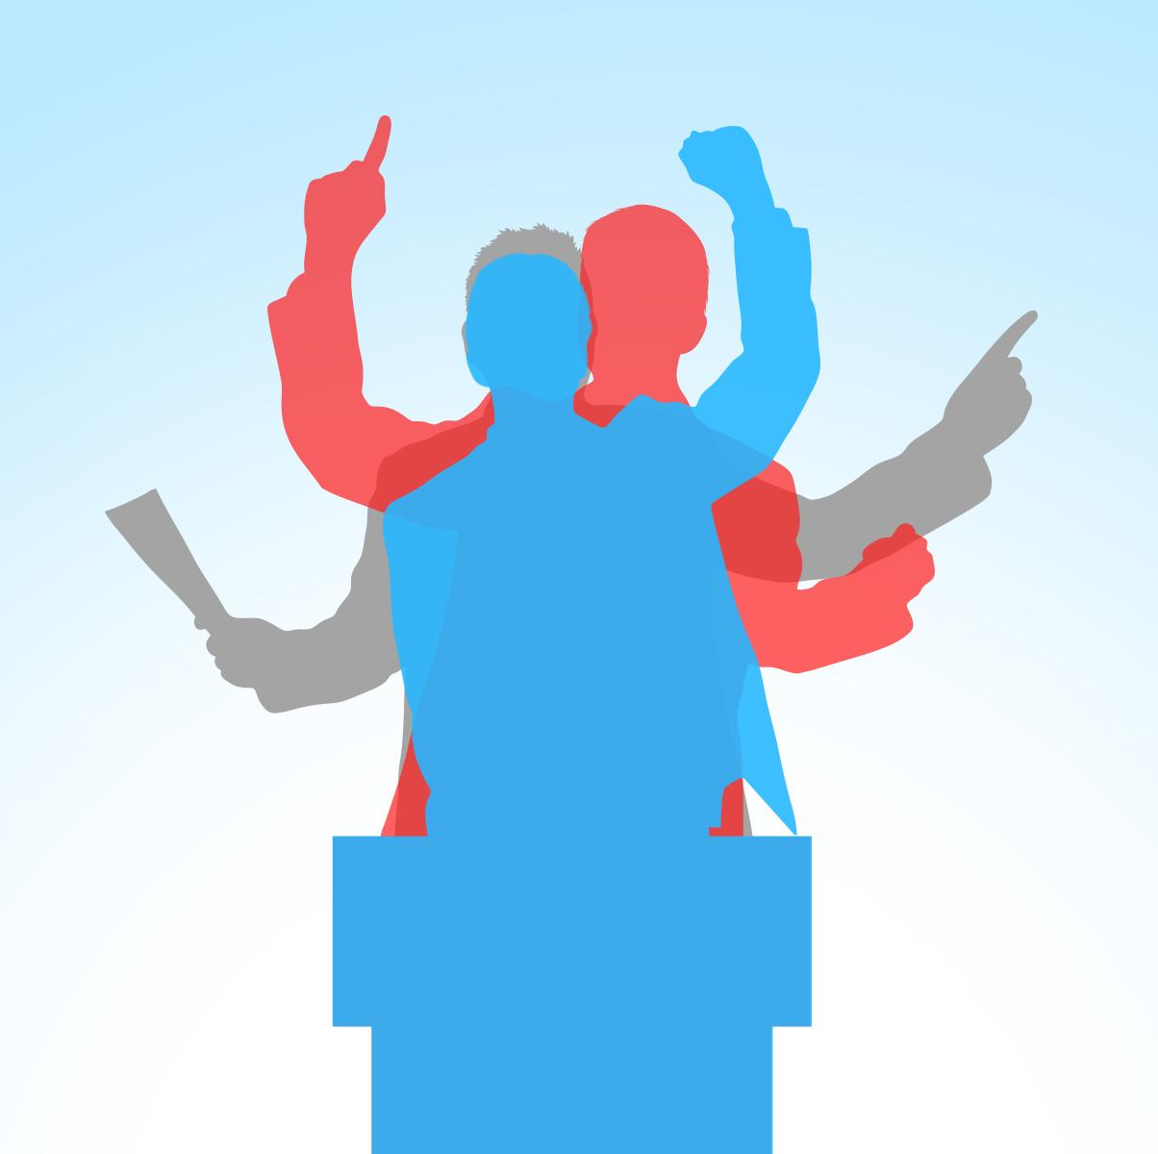
The Procedure
Roll Call
Policy Statements
Lobbying & Merging
Debate
Operative Clauses
Speeches
POIs
Amendments
Voting

Slide 3

Roll Call
It is conducted when each session begins (e.g. after a break or lobbying)
It verifies attendance
When hearing their country’s name each delegate should raise their placard and state one of the following:
i) Present
ii) Present and voting, which means that in future voting procedures the delegate may only vote in favor or against. They may not abstain

Slide 4

Policy Statements
An optional speech stating the view of a country on the topics that will be discussed in the committee
It is around 30’-45’ long
They are introduced in the first session of each committee
Delegates are raised alphabetically
They are used for each delegate to find other delegates with the same views as theirs
One speech for all committee topics

Slide 5
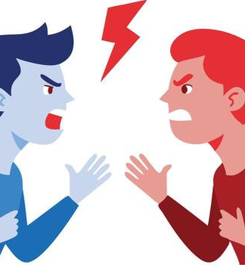
Lobbying & Merging
Delegates are allowed to move freely around the room and discuss with other delegates
The goal is to create a collective resolution with everyone’s ideas
Delegates should create alliances with countries that share the same views as theirs on the corresponding topic
Formal and English conversations are required at all times
Resolutions should be in UN Resolution format
Each resolution should have at least 4 preambulatory clauses (stating facts) and at least 6 operative clauses (solutions)
Around 1,5 hour / topic for GA Committees and the SC
Around 1 hour / topic for the rest non-GA Committees
A Main-Submitter must be selected and all other allies co-sign as Co-Sumbitters

Slide 6

Resolution
Preambulatory clauses: They briefly state the situation (historic background, past UN resolutions and decisions, current events)
Operative clauses: They contain delegates’ solutions to the issue (research by each delegate is needed)
The opening phrase of a preambulatory clause is in italics
The opening phrase of an operative clause is underlined and bold
A clause can be further split into sub- and sub-sub- clauses
Semi-colons (;) separate two full clause
Colons (:) separate a clause from its sub-clauses
The only full stop (.) comes after the final operative clause.
The correct font and size for resolutions is Arial, size 12

Slide 7
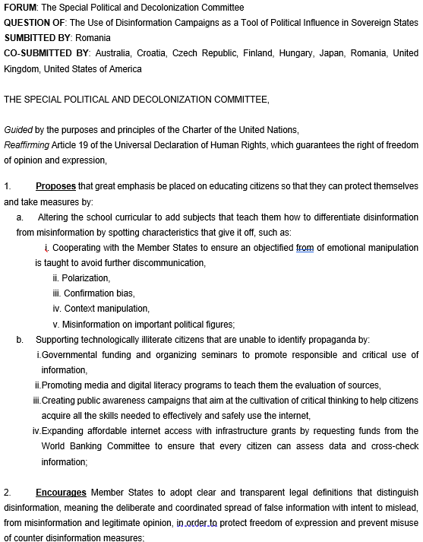
Heading
Preambulatory Clauses
Operative Clauses

Slide 8

Debate Modes
Open Debate
Closed Debate
During open debate any delegate can take the floor without restriction based on their position and make a speech
This format is used for the duration of the main procedure
During close debate time is equally divided between time in favor and against
Delegates take the floor with their intentions known to the house
Used for amendments

Slide 9

Amendments
An amendment is made when a delegation wants to change something about the resolution being debated at the time
When an amendment is proposed debate time is paused and it gets displayed on the board
The submitter is called to present the amendment
The Chairs set debate time on the amendment with specific number of speeches in favor and against (closed debate time)
The rest of the procedure is the same as when debating a resolution
If the amendment passes it is adopted in the resolution

Slide 10
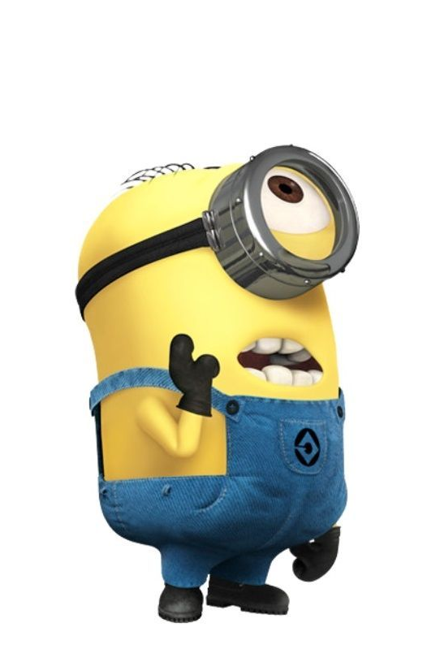
Amendments
First-degree amendment:
Add a clause
Strike out a clause
Amend a clause
Second-degree amendment: An amendment to the amendment being debated at the time
Friendly amendment:
Corrects minor issues
If the main submitter of the resolution agrees it passes automatically , if not , the debate on the amendment begins

Slide 11
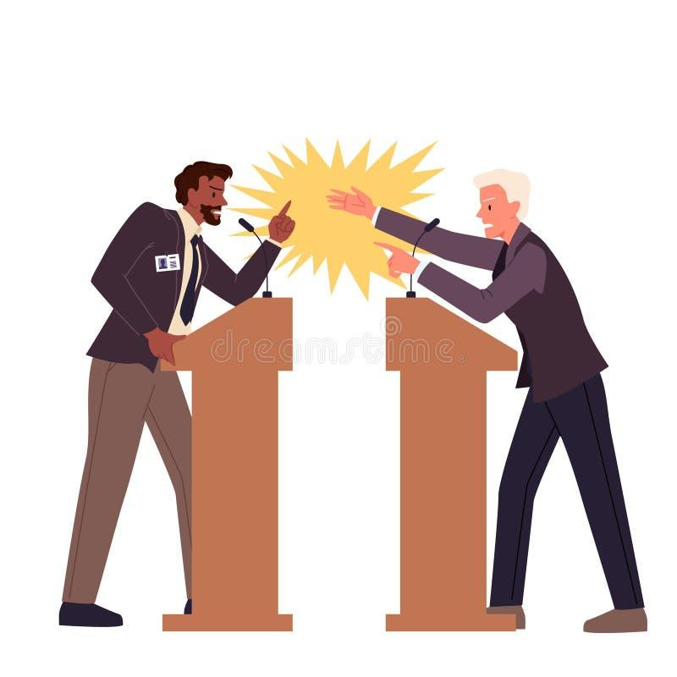
Debate
The Main-Submitter reads the Operative Clauses
The Chairs set Open Debate Time and Guillotine Time
Guillotine time:
Total time that will be spent debating on a resolution
Consists of the open debate time, the closed debate time, and every other procedure during the debate on a resolution.
The Main-Submitter reads a speech in favor of the resolution (if they have one)
The Chairs ask them if they are open to any POIs and the respond:
No
Up to …
Any and all
The delegates are asked to raise their placards if they have any POIs
The chairs recognize them according to the time remaining and the committee’s need
The delegates make POIs in the order in which they were recognized
No direct dialogue between delegates
The Chair always asks if the point is well taken
When the floor is open, the chairs ask for delegates to deliver a speech according to the current debate mode
Amendments are entertained by the chairs according to the committee’s needs following the same procedure with Closed Debate mode

Slide 12

Yielding
Once POIs have been answered the delegate will be asked how to they wish to yield the floor
They can say:
We / The delegate / The delegation of yield(s) the floor to the chairs
We / The delegate / The delegation of yield(s) to X delegation (only one time)
No yielding chains (e.g. Sweden → France → China)

Slide 13

Points
Point of Order: Delegates use this point when they believe there has been a breach of procedure or rules of the conference. The Chair decides whether the point is valid and addresses it accordingly.
Point of Parliamentary Inquiry: Delegates raise this point to seek clarification about the rules or procedures. It can be used to ask questions about how the committee is functioning.
Point of Personal Privilege: This point is raised when a delegate's well-being is affected, such as a problem with temperature, noise, or technical issues. It's the only point that can interrupt the speaker, usually for audibility problems.
Point of Information (POI): This point is a question and must be in the form of a question. It can be used to a delegate who is open to such points or to the chairs. It cannot interrupt anyone. It can also be used as a Point of Information to the Chairs

Slide 14

Motions
Second: Delegates will use it when a Motion (only in those that should be a second) is proposed and want to get accepted.
Objection: Delegates will use it when a Motion (only in those that should be a second) is proposed and disagree in its acceptance.

Slide 15

Motions
Motion to Extend Debate Time: This motion is used to prolong the debate on the topic at the moment. It requires a second. If anyone objects, the procedure continues normally.
Motion to Follow up: This motion is requested when the delegate’s question to the speaker on the floor has not been clarified or wishes for an additional question. It can only be used once after a POI. Chairs will decide if it is granted or not, considering to how many POIs the delegate is open.
Motion to Table the Resolution: This motion is used to propose to stop considering a resolution if it has little support and is pointless to debate. It requires a second. If anyone objects, the debate continues normally.
Motion to Move the Previous Question: This motion is used to propose to end the debate and to vote on the resolution or amendment in question. It requires a second. If anyone objects, the debate continues normally.
Motion to Approach the Chairs: This point is a request to discuss a problem with the Chair privately.

Slide 16

Motions
Motion to Divide the House: This motion is made when delegates want the whole committee to vote again without permitting the delegates to ABSTAIN (the delegates can only vote IN FAVOR or AGAINST). The chairs accept it if it can change the outcome of the voting procedure. It requires a second. If anyone objects, the procedure continues normally.
Motion to Pass this Amendment as Friendly: This motion is proposed in order to end the debate of an amendment. It requires the Main-Submitter approval. If it is objected, the debate continues normally.
Motion for a Roll Call Vote: This motion is used when delegates request a formal roll call vote to record each country's position. It requires a second. If it is objected, the voting continues normally.
Motion for a Recess: Delegates may request a temporary break in the session for various reasons, such as consultations, drafting, or simply a rest. It requires a second. If anyone objects, the procedure continues normally.

Slide 17
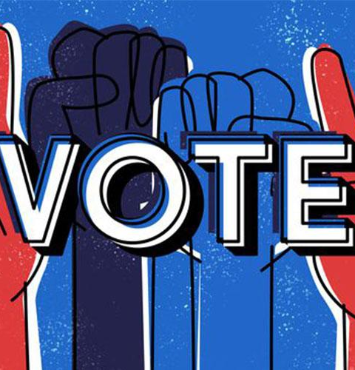
Voting
Following the debate period, a vote on the entire resolution or amendment will be held.
Chairs say: “We will be moving on to the voting procedure. Any guests are kindly asked to exit the room, note – passing is suspended and staff please take your voting positions”
When the chairs announce that the committee is beginning the voting process, neither advisors nor guests are permitted to enter the room. Only the members of the Secretariat and the OT are allowed to be present during the voting Procedure.
Additionally, during the process, every delegate should be present in the room.
At the chair's request, each delegate should raise their placard and vote IN FAVOUR, AGAINST, or ABSTAIN (only if they selected "Present" on the roll call). Only when instructed to do so may delegates rise and lower their placard. This will guarantee that every vote has been counted.

Slide 18

Note Passing
Delegates may use them to communicate with other delegated, usually to ask or answer a question.
A delegate may say “We will answer via note” when answering a POI and later reply as said.
They are given to the Staff who they read them to ensure that the content is in English, it is not offensive and is relevant to the procedure.

Slide 19

Rules
English is the official language of the conference
Chairs should at all times stay in their committees
Delegates may not use personal pronouns, such as:
I, me, mine, etc.
Instead, they may use:
“The delegate”,
”The delegation of”,
”We”

